Slide 1
Better Census Bureau
Sam Robinson, Sandra Medrano, Henry Wycislo,
and John Burke

Slide 2
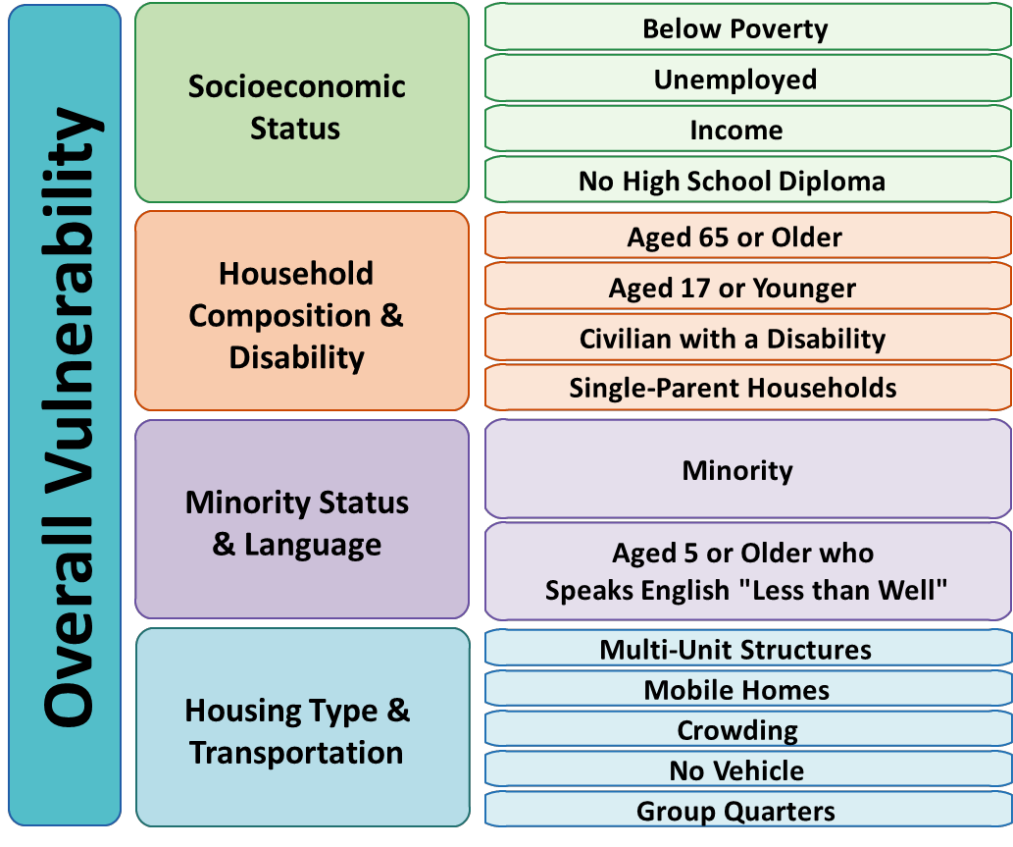
What defines Social vulnerability?

Slide 3
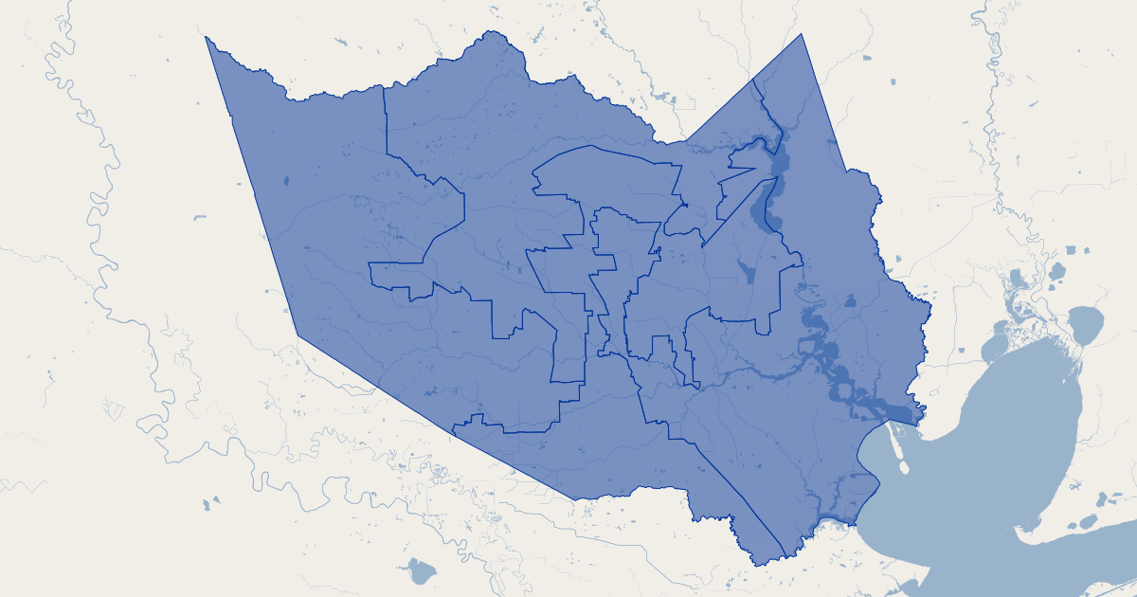
Context
Provide data visualization dashboard of Houston’s Harris County various census metrics and how they relate to each geographic location.

Slide 4
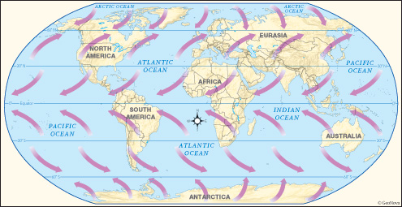
The effects of prevailing winds

Slide 5
Questions
What are any inherent biases for how the data is collected?
How is the population split geographically in terms of education, social vulnerability and income, and how does this compare to the national data?
How does Harris County compare to the U.S.?

Slide 6





Tools we used
HTML
CSS
JavaScript
GeoJSON
Python
Pandas
GeoPandas
PostgresSQL
Leaflet

Slide 7


Datasets USED

Slide 8
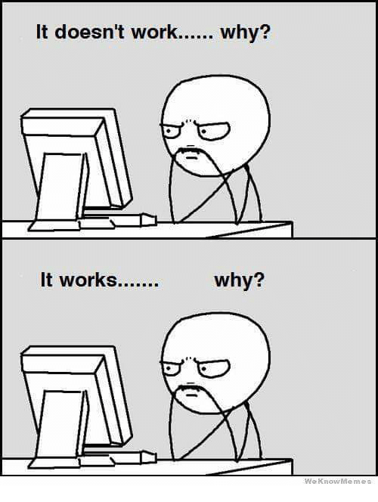
Difficulties we faced

Slide 9
Fin

